Slide 1
Chapter 9:
Introduction to Sorting
(From a Different Book)
Data Abstraction & Problem Solving with
C++
Fifth Edition
by Frank M. Carrano

Slide 2
The Efficiency of Searching Algorithms - Recap
Sequential search
  Strategy
    Look at each item in the data collection in turn
    Stop when the desired item is found, or the end of the data is reached
  Efficiency
    Worst case:
      O(n)
    Average case:
      O(n)
    Best case:
      O(1)

Slide 3
The Efficiency of Searching Algorithms - Recap
Binary search of a sorted array
  Strategy
    Repeatedly divide the array in half
    Determine which half could contain the item, and discard the other half
  Efficiency
    Worst case:
      O(log₂n)
    For large arrays, the binary search has an enormous advantage over a sequential search
      At most 20 comparisons to search an array of one million items

Slide 4
Sorting Algorithms and Their Efficiency
Sorting
  A process that organizes a collection of data into either ascending or descending order
  The sort key
    The part of a data item that we consider when sorting a data collection

Slide 5
Sorting Algorithms and Their Efficiency
Categories of sorting algorithms
  An internal sort
    Requires that the collection of data fit entirely in the computer’s main memory
  An external sort
    The collection of data will not fit in the computer’s main memory all at once, but must reside in secondary storage

Slide 6
Selection Sort
Strategy
  Place the largest (or smallest) item in its correct place
  Place the next largest (or next smallest) item in its correct place, and so on

Slide 7
Selection Sort
void selectionSort(DataType theArray[ ], int n)
{
for (int last = n-1; last >= 1; last--)
{
int largest = indexOfLargest(theArray, last+1);
swap(theArray[largest], theArray[last]);
}
}
int indexOfLargest(const DataType theArray[ ], int size)
{
int indexSoFar = 0;
for (int currentIndex = 1; currentIndex < size; currentIndex++)
{
if (theArray[currentIndex] > theArray[indexSoFar])
indexSoFar = currentIndex;
}
return indexSoFar;
}
void swap( ) <⬅ Just swaps two items passed in

Slide 8
Selection Sort
Analysis
  Worst case:
    O(n²)
  Average case:
    O(n²)
Does not depend on the initial arrangement of the data
Only appropriate for small n

Slide 9
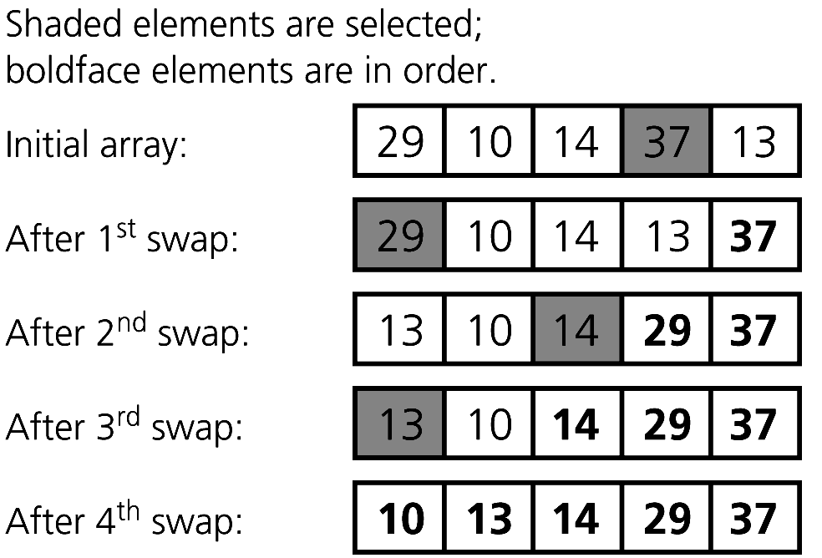
Selection Sort
Figure 9-4 A selection sort of an array of five integers

Slide 10
Bubble Sort
Strategy
  Compare adjacent elements and exchange them if they are out of order
    Moves the largest (or smallest) elements to the end of the array
    Repeating this process eventually sorts the array into ascending (or descending) order

Slide 11
Bubble Sort
void bubbleSort(DataType theArray[ ], int n)
{
bool sorted = false;
for (int pass = 1; (pass < n) && !sorted; ++pass)
{
sorted = true;
for (int index = 0; index <n-pass; ++index)
{
int nextIndex = index + 1;
if (theArray[index] > theArray[nextIndex])
{
swap(theArray[index], theArray[nextIndex]);
sorted = false;
}
}
}
}
void swap() ) <⬅ Just swaps two items passed in

Slide 12
Bubble Sort
Analysis
  Worst case:
    O(n²)
  Best case:
    O(n)

Slide 13
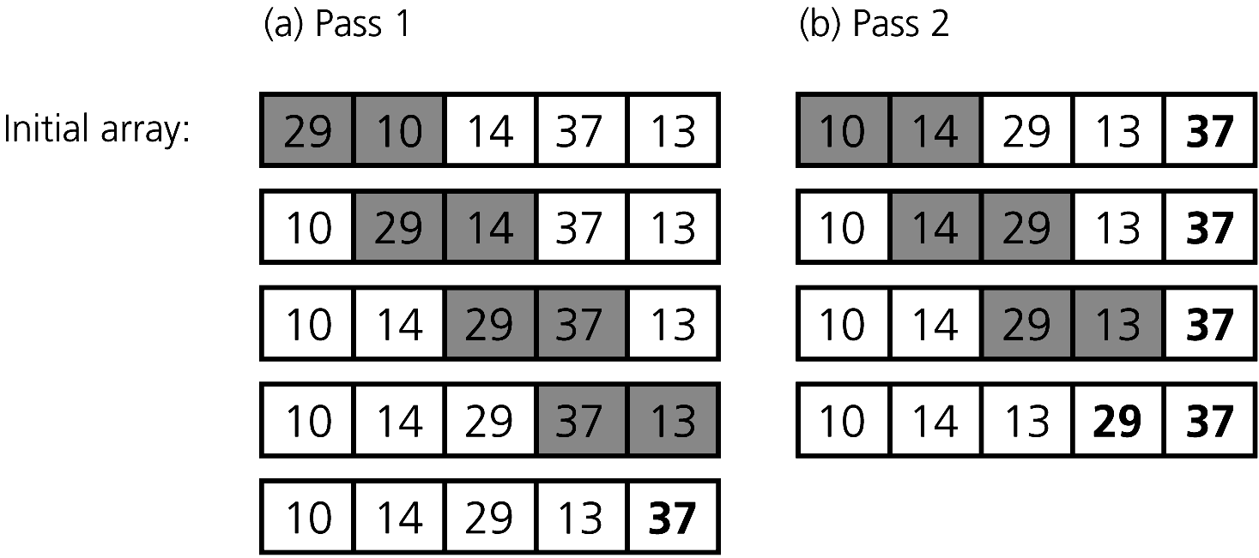
Bubble Sort
Figure 9-5
The first two passes of a bubble sort of an array of five integers: (a) pass 1; (b) pass 2

Slide 14
Insertion Sort
Strategy
  Partition the array into two regions: sorted and unsorted
    Take each item from the unsorted region and insert it into its correct order in the sorted region

Slide 15
Insertion Sort
void insertionSort(DataType theArray[ ], int n)
{
for (int unsorted = 1; unsorted< n; ++unsorted)
{
DataType nextItem = theArray[unsorted];
int loc = unsorted;
for (; (loc > 0) && (theArary[loc-1] > nextItem; --loc)
{
theArray[loc] = theArray[loc-1];
}
theArray[loc] = nextItem;
}
}

Slide 16
Insertion Sort
Analysis
  Worst case:
    O(n²)
      Appropriate for small arrays due to its simplicity
      Prohibitively inefficient for large arrays

Slide 17
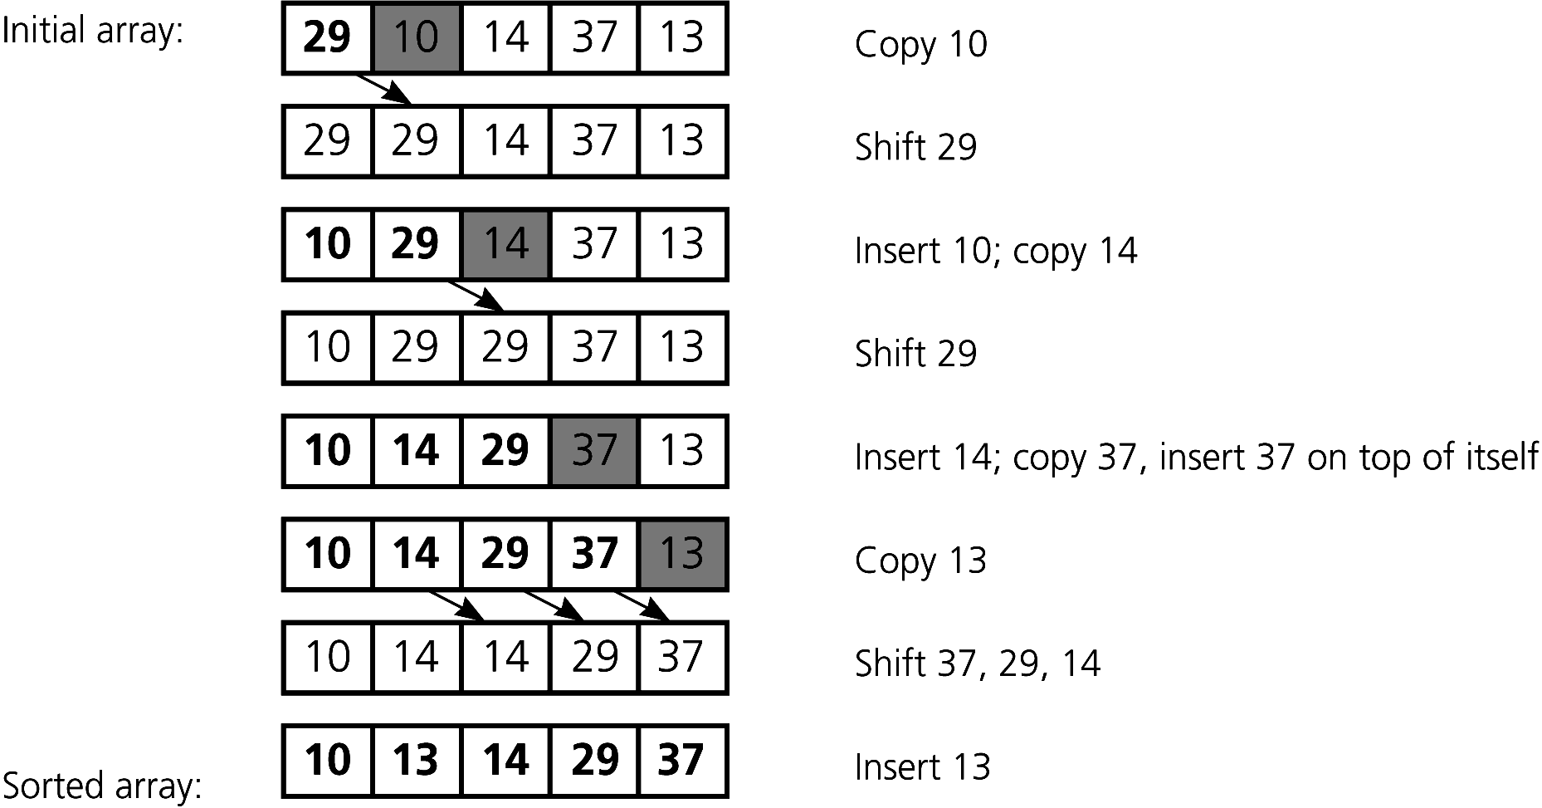
Insertion Sort
Figure 9-7 An insertion sort of an array of five integers.

Slide 18
Mergesort
A recursive sorting algorithm
Performance is independent of the initial order of the array items
Strategy
  Divide an array into halves
  Sort each half
  Merge the sorted halves into one sorted array
  Divide-and-conquer

Slide 19
Mergesort
void mergeSort(DataType theArray[ ], int first, int last)
{
if (first < last)
{
//sort first half
int mid = (first + last) / 2;
mergeSort(theArray, first, mid);
//sort second half
mergeSort(theArray, mid+1, last);
//merge two halves
merge(theArray, first, mid, last);
}
}
* Merge Algorithm too long for a slide – see Google

Slide 20
Mergesort
Analysis
  Worst case:
    O(n * log₂n)
  Average case:
    O(n * log₂n)
  Advantage
    Mergesort is an extremely fast algorithm
  Disadvantage
    Mergesort requires a second array as large as the original array

Slide 21
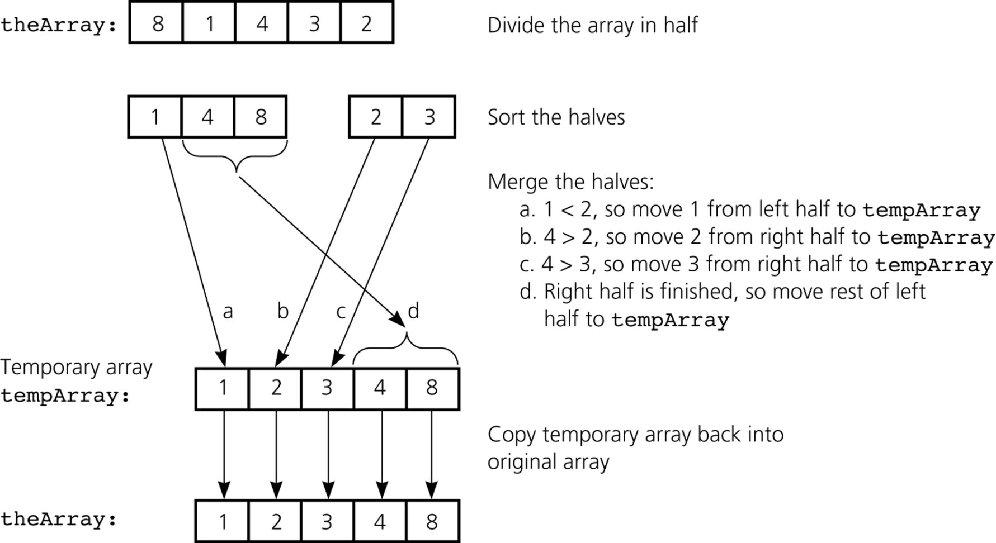
Mergesort
Figure 9-8 A mergesort with an auxiliary temporary array

Slide 22
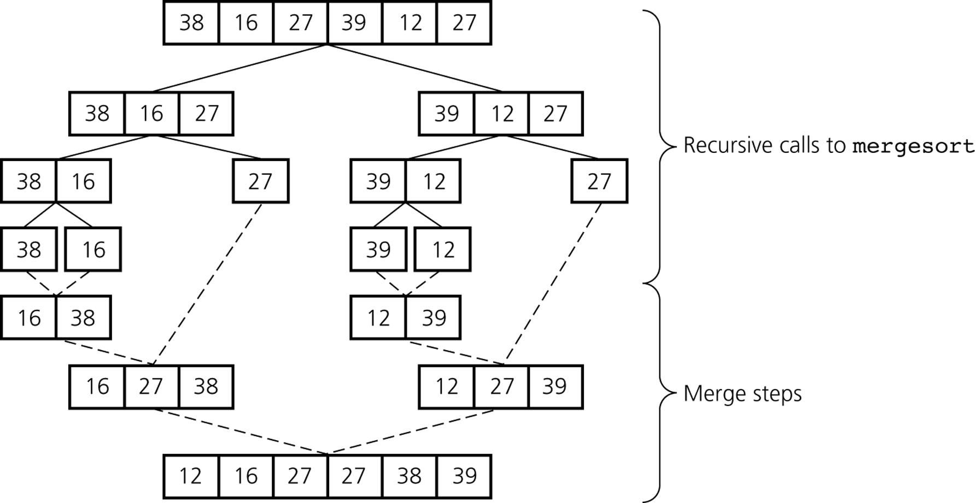
Mergesort
Figure 9-9 A mergesort of an array of six integers

Slide 23
Quicksort
A divide-and-conquer algorithm
Strategy
  Choose a pivot
  Partition the array about the pivot
    items < pivot
    items >= pivot
    Pivot is now in correct sorted position
  Sort the left section
  Sort the right section

Slide 24
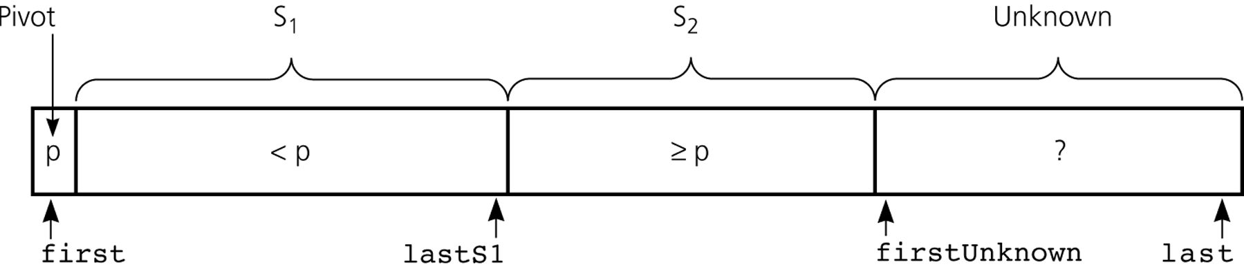
Quicksort
Using an invariant to develop a partition algorithm
  The items in region S₁ are all less than the pivot, and those in S₂ are all greater than or equal to the pivot
Figure 9-14 Invariant for the partition algorithm

Slide 25
QuickSort
//Easier solution than one in book
void quickSort(DataType theArray[], int low, int high)
{
_{int part;}
_{if (low < high) {}
_{//partition the list}
part = Partition(theArray, low, high);
_{//sort the left side}
quickSort(theArray, low, part-1);
_{//sort the right side}
quickSort(theArray, part+1, high);
}
_{else cout << "list sorted";}
}

Slide 26
QuickSort
int Partition(int a[], int low, int high)
{
int up, down, pivot, temp;
pivot = a[low];
up = high;
down = low;
while (down < up) {
while ((a[down] <= pivot) && (down < high))
down++;
while (a[up] > pivot)
up--;
if (down < up) {
temp = a[up];
a[up] = a[down];
a[down] = temp;
}
}
a[low] = a[up];
a[up] = pivot;
return(up);
}

Slide 27
Quicksort
Analysis
  Average case: O(n * log₂n)
  Worst case: O(n²)
    When the array is already sorted and the smallest item is chosen as the pivot
  Quicksort is usually extremely fast in practice
  Even if the worst case occurs, quicksort’s performance is acceptable for moderately large arrays

Slide 28
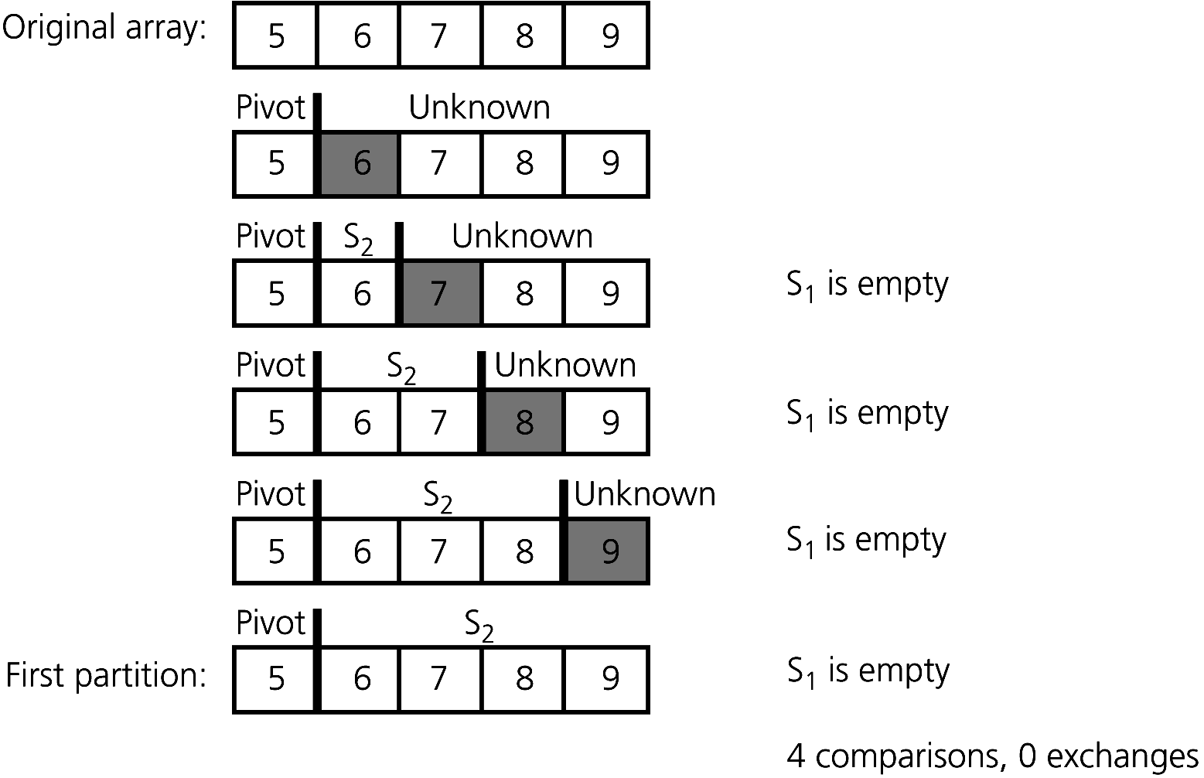
Quicksort
Figure 9-19 A worst-case partitioning with quicksort

Slide 29
Radix Sort – Not covered in this class
Strategy
  Treats each data element as a character string
  Repeatedly organizes the data into groups according to the i^{th} character in each element
Analysis
  Radix sort is O(n)

Slide 30
Summary
Order-of-magnitude analysis and Big O notation measure an algorithm’s time requirement as a function of the problem size by using a growth-rate function
To compare the efficiency of algorithms
  Examine growth-rate functions when problems are large
  Consider only significant differences in growth-rate functions

Slide 31
Summary
Worst-case and average-case analyses
  Worst-case analysis considers the maximum amount of work an algorithm will require on a problem of a given size
  Average-case analysis considers the expected amount of work that an algorithm will require on a problem of a given size

Slide 32
Summary
Order-of-magnitude analysis can be the basis of your choice of an ADT implementation
Selection sort, bubble sort, and insertion sort are all O(n²) algorithms
Quicksort and mergesort are two very fast recursive sorting algorithms

